Slide 1


Supershop Analytical Business Case Study
Objective:
To provide an overview of the current week’s operations, analyze the on-time performance of orders and provide recommendations for any improvements
Assumptions:
I’m assuming that only future orders can have an early delivery and that immediate orders can only be delivered on-time or late
I’m assuming that duplicate order ID’s count as unique orders as they correspond to different shopper, store and day of the week
Submitted by Gabriela Roestandy

Slide 2
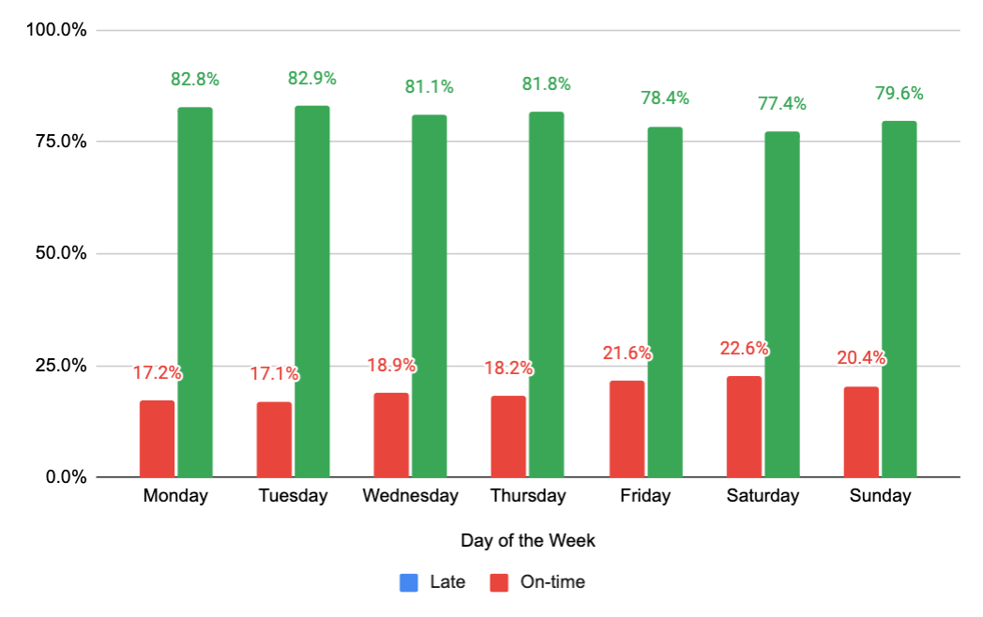
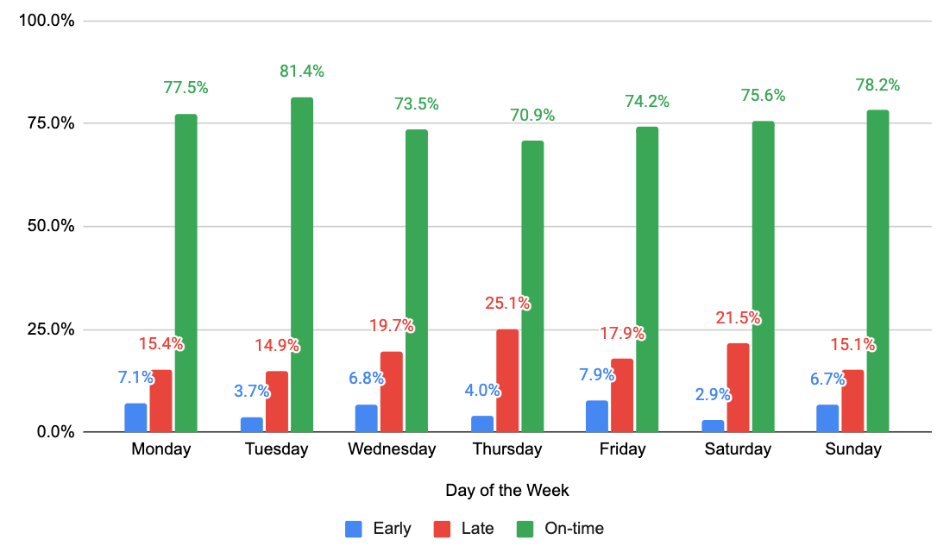

Current
Week
Overview:
Market X
Top 5 Stores:
Store ID Order Qty
537 5523
613 2289
538 254
3376 240
7877 137
Top 5 Shoppers:
Shopper ID Order Qty
1089 157
1150 154
1183 149
1107 144
1136 130
Total Orders:
8,671
1% Early*
19% Late
80% On-time
Total Shoppers:
369
1% Early*
29% Late
70% On-time
Average Order Size:
12 items
On-time Performance for Immediate Orders (85% of total orders)
On-time Performance for Future Orders (15% of total orders)
All orders are below the 90% on-time standard for each day of the week
It appears that weekends have lower on-time rates for immediate orders, but not by a significant amount- could be due to increased traffic at stores
*Future orders only
Notes:
This is the state of the marketplace- concise claim- tell them the problems, this is why, back that up w the graphs

Slide 3
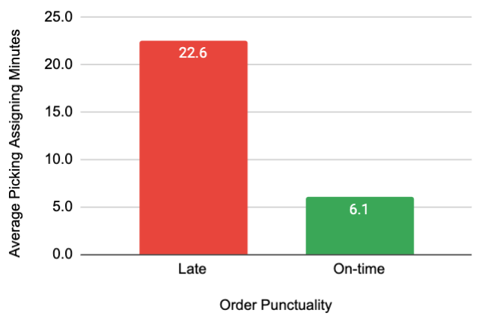
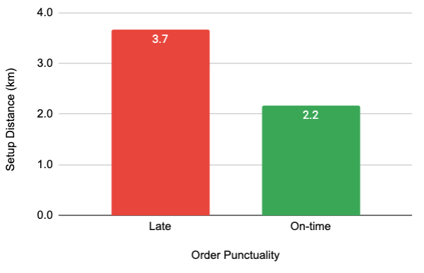
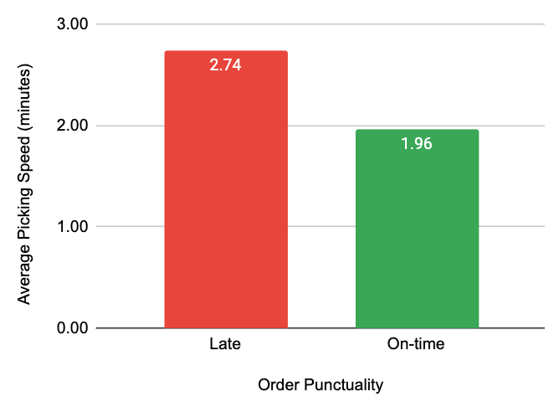
The most important variables affecting on-time delivery appear to be:
Picking Assigning Time, Distance & Picking Speed
1
It takes almost 4x as long for a late order to be accepted by a shopper compared to on-time orders
2
Late orders tend to have the farthest km distance between shopper and store location
3
Late orders tend to have a higher picking speed average by almost 40% compared to on-time orders
What is causing a shopper to take a long time to accept the orders that end up being late in graph 1?
Late orders tend to have a farther setup distance as seen in graph 2, around 68% further than orders that are on-time. This might cause a shopper to hesitate accepting an order that is far, and instead wait to see if a closer order will pop up before they decide to accept the further ones
The higher picking speed average for late orders in graph 3 could be due to the type of products being ordered and the availability and searchability of those products. More detailed product order data would be needed to further investigate this, but this could be another factor in determining a shopper’s likelihood of accepting an order more quickly
Note: I have taken early data out in this analysis since they make up less than 1% of all orders to make it easier to focus on the late and on-time orders
Notes:
Might get a store question here

Slide 4
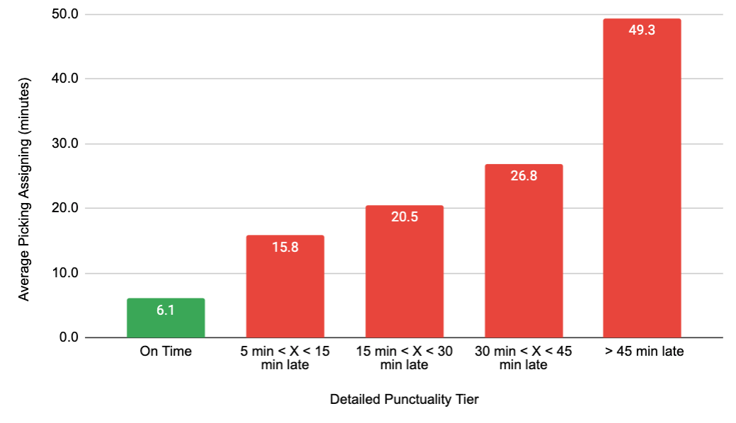
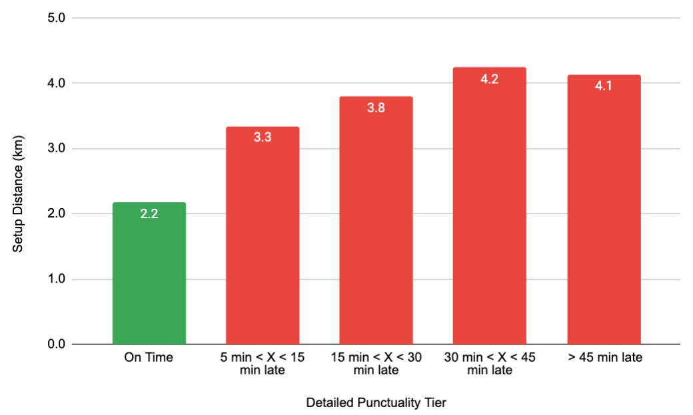
A further look into late orders
A shopper is able to take up to 15 minutes* to accept an order before that order becomes at least 5 minutes late
Once the 15 minute mark is passed, it only takes an extra 5 minutes of waiting before an order becomes incrementally 15 minutes late up to 45 minutes
If a shopper takes longer than 27 minutes to accept an order, then that order will likely be over 45 minutes late
If the initial picking assigning time is minimized, this could add a buffer for orders from crossing one tier to the next and improve overall punctuality
The cut-off setup distance of an order is 3.3 km before it enters the 5 – 15 minute late range
It takes an extra 0.5 km in setup distance for an order to become incrementally 15 minutes late up to 45 minutes
Orders that are 30 to over 45 minutes late hit a cut-off setup distance of around 4 km
On-time orders with a setup distance of 2 - 3 km have a 41% average picking acceptance rate while all subsequent late tiers have around 35% for distances farther than 3 km- this further indicates the preference of shorter setup distances for shoppers when accepting an order
Note: I have taken early data out in this analysis since they make up less than 1% of all orders to make it easier to focus on the late and on-time orders
*Assuming that the detailed punctuality tier takes into account the 5 minute buffer

Slide 5
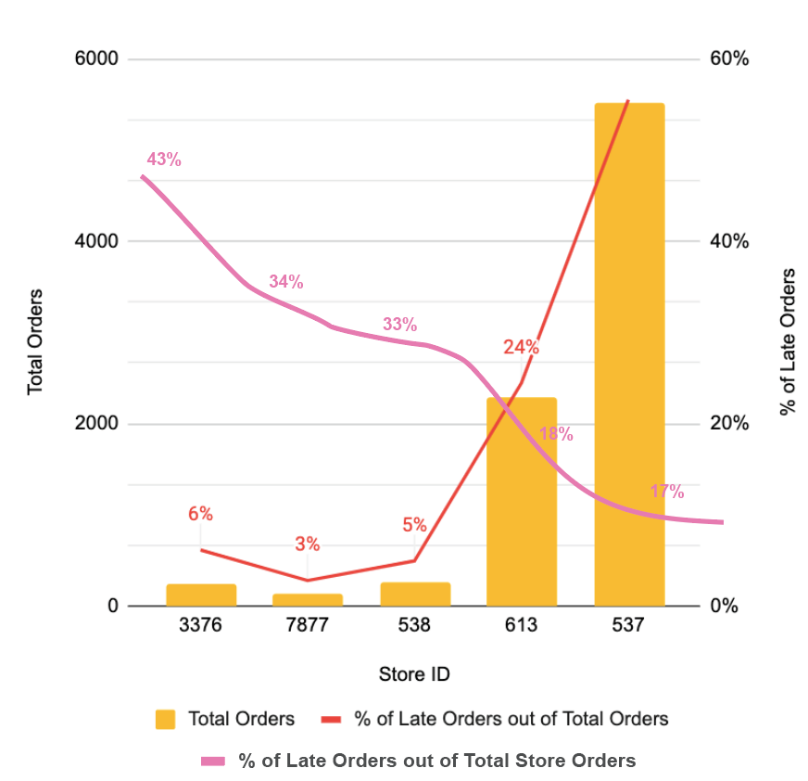
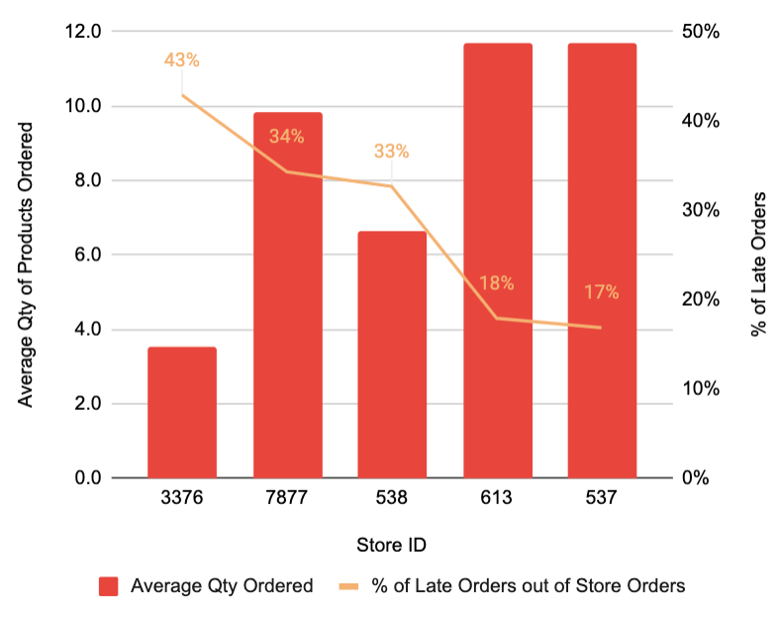
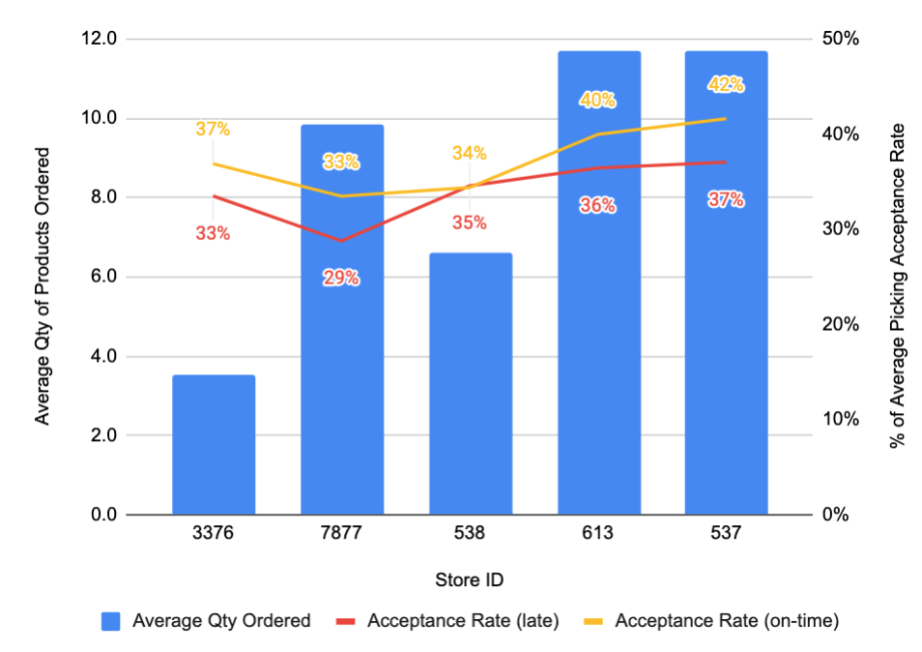
The most popular stores have the highest on-time delivery percentage
64% of all orders come from store 537, while 26% of all orders come from store 613- all other stores make up less than 2% of all orders. Though Store 537 and Store 613 both have the highest late percentage out of total orders, they have the lowest late percentage out of their respective total store orders as seen in graph 1.
Stores 538, 7877 and 3376 appear to have a much higher late percentage out of their respective total store orders, indicating poorer performance in on-time deliveries for lower order volume stores
1
% of Late Orders & Total Orders
2
% of Late Orders & Average Order Size
3
% Average Picking Acceptance Rate & Average Order Size
Why are stores 537 and 613 so popular with shoppers?
The average order size of store 537 and 613 is 68% higher than all other stores as seen in graph 2
In graph 3, store 537 and 613 have a much higher acceptance rate for both late and on – time orders compared to all other stores
The above indicate that shoppers have a preference of accepting orders from store 537 and 613, potentially due to the volume of orders and bigger order size coming from both popular stores. Additional data on both stores would be needed to determine external factors that might influence a shopper’s preference such as accessibility, product offering and store size/capacity
Notes:
Based on the previous slide, explain why and how I wanted to analyze the stores- this is what I was looking for, talk about the idea you had that led to these graphs
Need high level summary before each slide
Its ok to say that you are unsure, but highlight the question you wanted to ask
“This is what made me think of, If I could dig deeper, these are the additional questions I would have”
Be clear about what you want to learn more about and figure out
Do user research and ask shoppers about this -> get more qualitative data
Match drivers to stores that work better with their experience level
If I didn’t have time on something, go over what my approach would be, what questions I would ask and what variables I would analyze

Slide 6
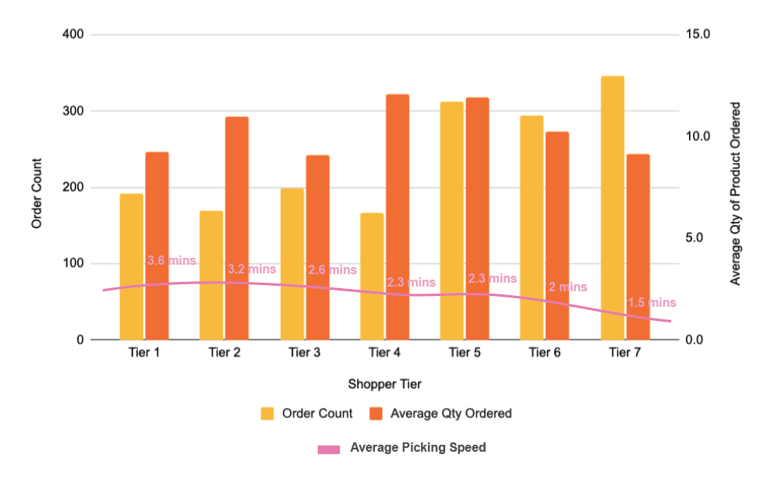
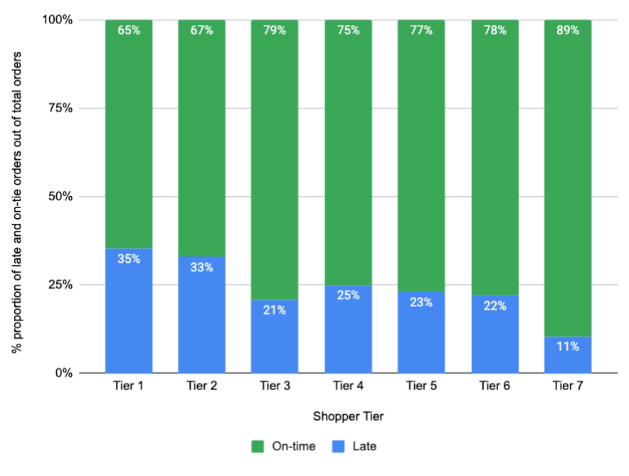
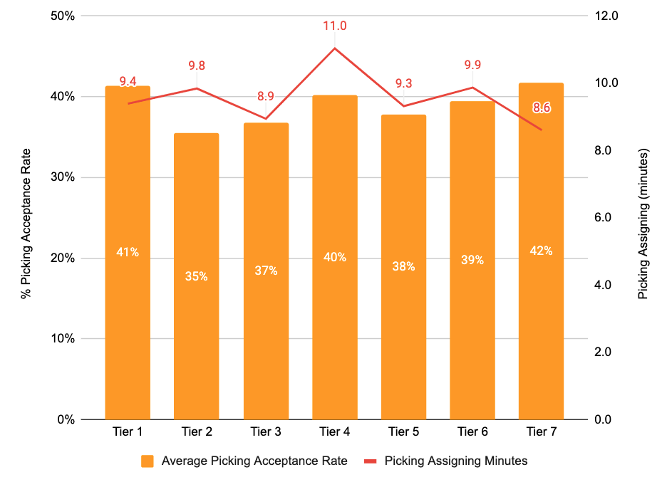
Shopper Tier Analysis & Behavior
Breakdown of Shoppers by Experience
There appears to be a more or less equal split of shoppers with different experience levels, with the highest 3 being the tier 1 (20%), tier 7 (18%) and tier 6 (17%)*
Order Count & Size by Shopper Tier
2
Order Punctuality by Shopper Tier
3
Picking Acceptance Rate & Assigning Time by Shopper Tier
1
Higher tiered shoppers tend to accept more orders with a higher quantity of products per order and become more efficient as the average picking speed gradually decreases as seen in graph 1
As a shopper completes more orders, they become more efficient and are able to satisfy bigger order sizes. While lower tiered shoppers complete a high number of orders, they tend to take on smaller order sizes
As shoppers complete more orders, the proportion of their orders that are completed on-time increases while late orders decreases. However, there is a fluctuation in the on-time improvement once a shopper starts to complete over 150 orders as seen in graph 2
As a shopper reaches 150 orders, their picking acceptance rate increases along with the picking assigning time. This could be due to shoppers becoming more selective about which orders they would like to fulfill as they now have more knowledge & experience about which orders would work better for them. More data on pricing and incentives could confirm this behavior
*Tier Legend/ % of All Shoppers
[0.0,25.0) | Tier 1 | 20%
[25.0,50.0) | Tier 2 | 10%
[50.0,100.0) | Tier 3 | 12%
[100.0,150.0) | Tier 4 | 9%
[150.0,250.0) | Tier 5 | 14%
[250.0,500.0) | Tier 6 | 17%
[500.0,inf) | Tier 7 | 18%

Slide 7
Summary & Recommendation
Based on the analysis performed, we can summarize the findings as follows:
The most important variables affecting on-time delivery appear to be picking assigning time, distance & picking speed
Late orders tend to have:
Higher picking assigning time average
Farther setup distance
Higher picking speed average
High initial picking assigning time is driving up overall punctuality
The most popular 2 stores have the highest on-time delivery percentage while low order volume stores have an overall lower on-time delivery percentage
As shoppers complete more orders, their productivity increases through a decrease in average picking speed and percentage of late deliveries
There are several strategies that can be implemented in order to improve the on-time delivery rate:
Incentivize shoppers to accept an order more quickly to reduce initial picking assigning time
Offer an incentive for shoppers to accept orders that are farther in distance- e.g. increase in pay incentive or extra points based on x amount of orders accepted for stores with a distance farther than 3 km
Examine current training provided to new shoppers/ lower tier shoppers in order to boost productivity
Provide extra guidance on how to maximize each shopping trip based on strategies used by more experienced shoppers
Closely monitor shopper performance metrics as they reach a different completed pickings tier in order to prevent shoppers from selectively choosing certain orders only
Add extra/new incentives for completing more orders once a a shopper hits a new completed pickings tier to maintain a consistently low picking acceptance rate
Notes:
Matching certain tasks with shoppers of a certain experience
Follow up investigations on what I would do next (next steps) -> more data I would get to learn more about these problems
How I would implement these recommendations
Be pretty self aware about the limitations – “here is an assumption I have, what data I need to strenghten that”

